Slide 1
FTC Day 0

Slide 2
What we’ll be covering today
FTC Day 0
What is FIRST
What is FTC
What was last year’s challenge?
What could be the next challenge?
How does FTC in India work?
How FTC Works

Slide 3
What we’ll be covering today
FTC Day 0
How can we win FTC?
QnA
Recap

Slide 4
What is FIRST?

Slide 5
What is FIRST?
FIRST, For Inspiration and Recognition of Science and Technology is an organization founded in New Hampshire in 1989 by Dean Kaman and the late Dr. Woodie Flowers.
FIRST organises multiple robotics competitions each year. They have 4 main programs- FLL, FTC, FGC and FRC.

Slide 6
What is FTC?

Slide 7
What is FTC?
FTC, First Tech Challenge is a robotics competition for children in grades 7-12.
The competition structure varies region by region. In the US, we start with leagues, or regional level competitions. The winners of these progress towards the state level challenge, the winner of which progresses towards the world championships in Houston, Texas.
Winning doesn’t only mean coming first. Alternative means include the Inspire Award.

Slide 8
What is FTC?
FTC has a single challenge that comes out at kickoff time, on September 21st this year. The challenge will be revealed with a video, with an accompanying document called the competition manual, which has all the details regarding the game.
This single challenge will persist till the end of the season in mid-March, when the world championships take place in Houston. The period between March and the next kickoff in September 2025 is the off-season.

Slide 9
What was last year’s challenge?

Slide 10
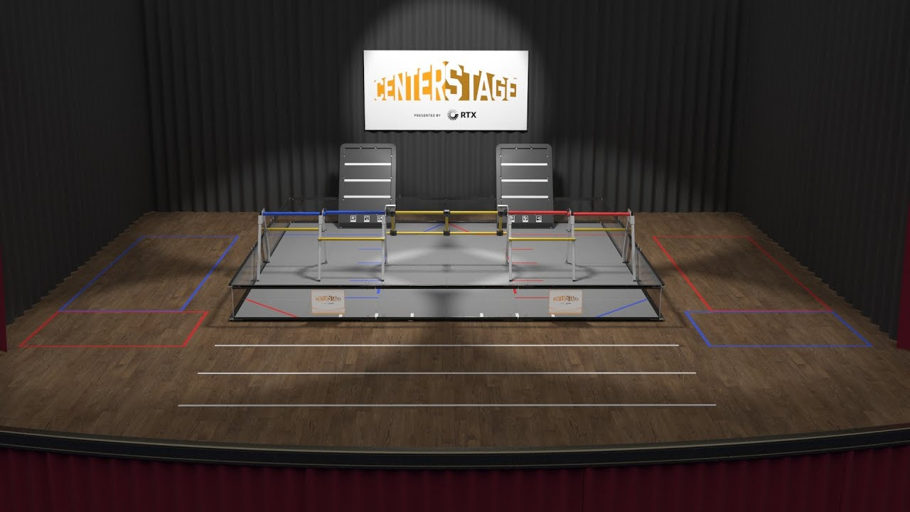

Slide 11
What was last year’s challenge?
Can you explain the challenge?
What strategies can you notice?
Any questions?
What’s the scoring like?

Slide 12
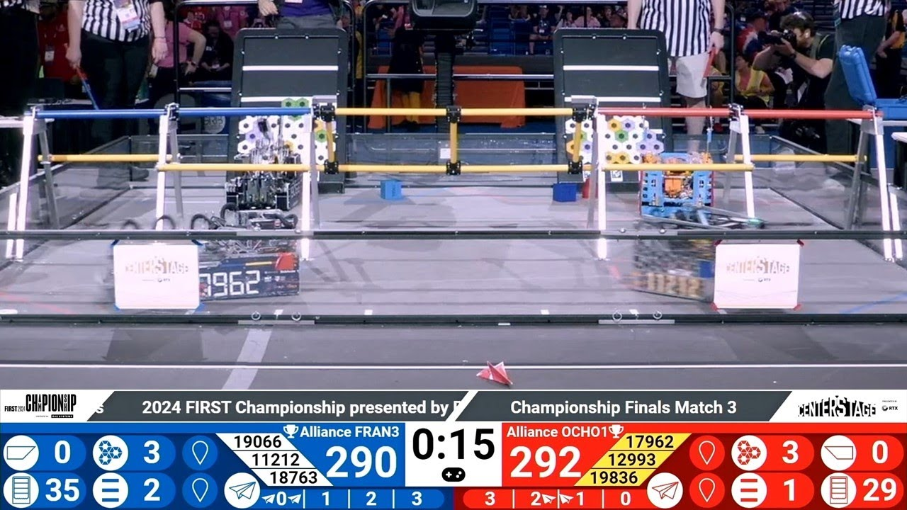

Slide 13
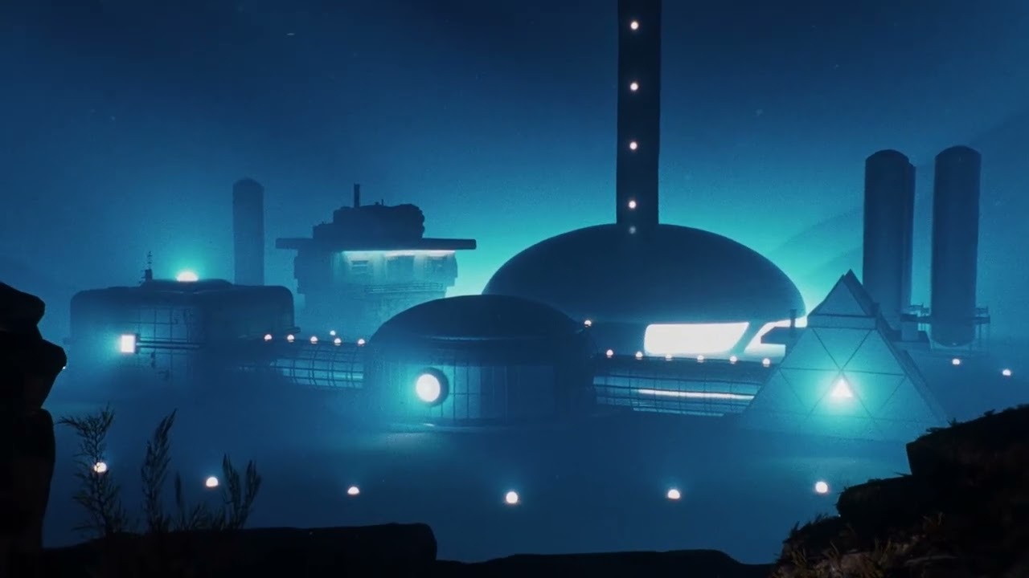

Slide 14
What do you think the next challenge could entail?

Slide 15
How does FTC in India work?

Slide 16
How does FTC in India work?
India this year will have two stages to FTC-
FTC League
FTC Regional
The FTC League will be a mini-tournament held in Mumbai, dates TBD, where they will have an FTC competition as normal. However, only the top 30-40 teams from here will move on to the FTC Regional to be held in Pune. This will be the main FTC event which will decide our progression to Houston.

Slide 17
How does FTC Work

Slide 18
How does FTC Work
Key Terms
Alliance
Qualifications and Playoffs
RPs, and TBPs

Slide 19
How can we win FTC?

Slide 20
How can we win FTC?
There are two main ways to “win” FTC-
Winning as an alliance captain
Inspire Award
Winning either will provide progression to Houston

Slide 21
Questions?

Slide 22
Recap

